Slide 1
HOUSING PRICE PREDICTOR
CAPSTONE 3
Kofi-Sakyi Assabil

Slide 2
Problem Statement:
Predict the final price of houses according to the market prices using different features of various houses
Help homebuyers know the value of a house they’re potentially going to buy
Help home sellers know the market price of their current property
Ultimately cut out middlemen in the form of realities and real estate agents to save both parties money

Slide 3
Scope of Solution Space:
Predict the price of homes accurately
Cut the middleman and save both parties money
Constraints within the solution space:
Dataset only provides us with houses in Ames, Iowa.
Model might not translate to other places outside Iowa
Stakeholders:
Home buyers
Home sellers

Slide 4
Dataset:
https://www.kaggle.com/c/house-prices-advanced-regression-techniques/data
79 Features (Dependent Variables)
1460 observations
Target variable is SalePrice

Slide 5
Data Wrangling:
Filled null values by column type:
int/float columns : filled null with mean of the column
object/categorical features: filled null with mode of the column
Dataset shape
1460 observations
79 initial columns
76 used columns

Slide 6
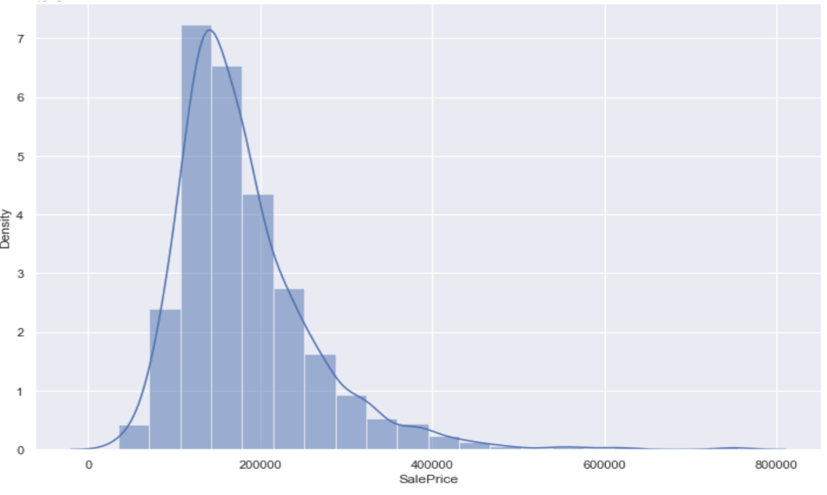
EDA:

Slide 7
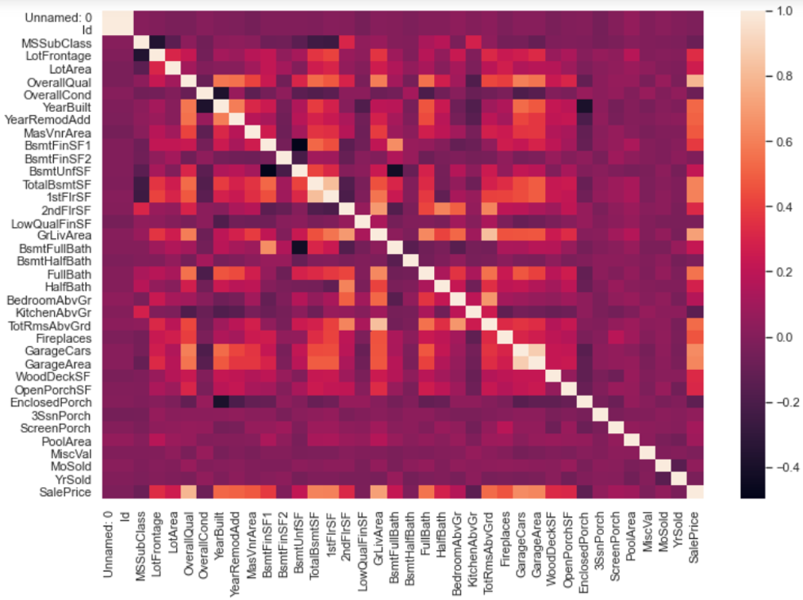
EDA cont:

Slide 8
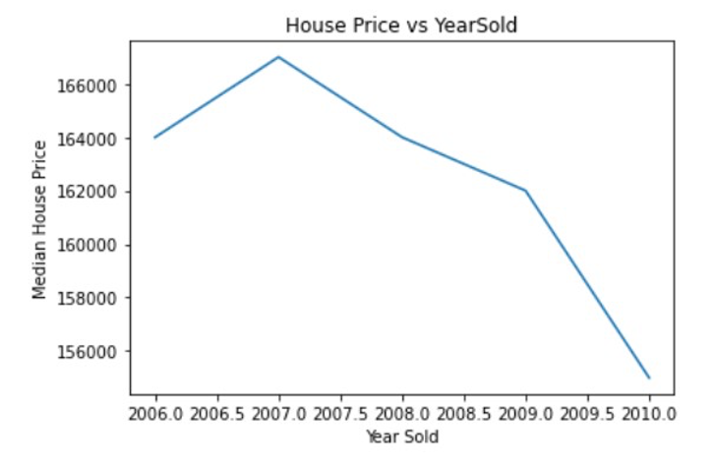
EDA cont:

Slide 9
Feature Engineering:
Filter features which have +ve or –ve impact on target variable.
Features impacting on target with same amount select one among them hence it reduces the feature size to 73.
Turn categorical variables into dummy variables and led to 275 columns.
Data Normalization.
Transform numeric columns to common scale
Split dataset into training and testing dataset.

Slide 10
Modeling:
Linear Regression:
RMSE : 3167375859.32285
R^2 : -18584463715.2345
Lasso Regression:
RMSE: 0.0165325026380271
R^2: 0.902996136530303

Slide 11
Conclusion
The algorithm that produced the most accurate and best metrics is the Lasso Regression
This model is able to predict housing prices accurately but it’s not also the best model
Model Improvement:
A much larger dataset
Use a dataset with other housing prices in different areas
Use other methods to create more models

